Slide 1


Maina Duseja
12th Sep 2023

Slide 2


Outline
Executive Summary
Introduction
Methodology
Data Collection
Results
Visualization – Charts
Dashboard
Discussion
Insights drawn from EDA
Launch Sites Proximities analysis
Dashboard with Plotly Dash
Predictive Analysis(Classification)
Conclusion
Appendix

Slide 3

Executive Summary
Summary of methodologies
Data Collection through API
Data Collection with Web Scraping
Data Wrangling
Exploratory Data Analysis with SQL
Exploratory Data Analysis with Data Visualization
Interactive Visual Analytics with Folium
Machine Learning Prediction
Summary of all results
Exploratory Data Analysis result
Interactive analytics in screenshots
Predictive Analytics result

Slide 4

Introduction
Project background and context
Space X advertises Falcon 9 rocket launches on its website with a cost of 62 million dollars; other providers cost upward of 165 million dollars each, much of the savings is because Space X can reuse the first stage. Therefore, if we can determine if the first stage will land, we can determine the cost of a launch. This information can be used if an alternate company wants to bid against space X for a rocket launch. This goal of the project is to create a machine learning pipeline to predict if the first stage will land successfully.
Problems you want to find answers
What factors determine if the rocket will land successfully?
The interaction amongst various features that determine the success rate of a successful landing.
What operating conditions needs to be in place to ensure a successful landing program.

Slide 5

Section 1

Slide 6

Methodology
Executive Summary
1) Data collection methodology :
Data from SpaceX was obtained from two sources:
SpaceX API -> https://api.spacexdata.com/v4/ (having endpoints /capsules and /cores and launches/past)
WebScraping (https://en.wikipedia.org/wiki/List_of_Falcon/_9/_and_Falcon_Heavy_launches)
To be continued.

Slide 7
Methodology
Executive Summary
2) Perform data wrangling :
One-hot encoding was applied to categorical features
Collected data was enriched by creating a landing outcome label based on outcome data after summarizing and analyzing features.
3) Perform exploratory data analysis (EDA) using visualization and SQL
4) Perform interactive visual analytics using Folium and Plotly Dash
To be continued.

Slide 8
Methodology
Executive Summary
5) Perform predictive analysis using classification models :
Data that was collected until this step were normalized, divided in training and test data sets and evaluated by four different classification models, being the accuracy of each model evaluated using different combinations of parameters.

Slide 9

Data Collection
Describe how data sets were collected.
Data from SpaceX was obtained from two sources:
SpaceX API -> https://api.spacexdata.com/v4/ (having endpoints /capsules and /cores and launches/past)
WebScraping (https://en.wikipedia.org/wiki/List_of_Falcon/_9/_and_Falcon_Heavy_launches)

Slide 10
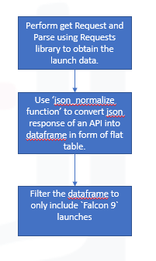
Data Collection – SpaceX API
SpaceX offers a public API from where data can be obtained and then used;
This API was used according to the flowchart beside and then data is persisted.
Source code Reference:
https://github.com/maina-duseja/DS-Capstone/blob/main/jupyter-labs-spacex-data-collection-api.ipynb

Slide 11
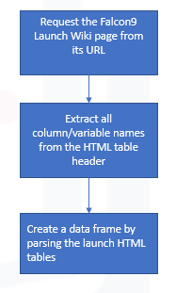
Data Collection - Scraping
Data from SpaceX launches can also be obtained from Wikipedia;
• Data are downloaded from Wikipedia according to the flowchart and then persisted.
Source code Reference:
https://github.com/maina-duseja/DS-Capstone/blob/main/jupyter-labs-webscraping.ipynb

Slide 12
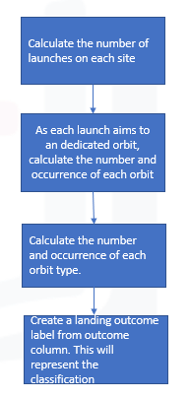
Data Wrangling
Initially Exploratory Data Analysis (EDA) was performed on the dataset.
Then the summary launches per site, occurrences of each orbit and occurrences of mission outcome per orbit type were calculated.
Finally, the landing outcome label was created from Outcome column.
Source code Reference:
https://github.com/maina-duseja/DS-Capstone/blob/main/labs-jupyter-spacex-data_wrangling_jupyterlite.jupyterlite.ipynb

Slide 13
EDA with Data Visualization
In this we performed exploratory Data analysis and Feature engineering using Pandas and Matplotlib.
To explore data, scatterplots and bar plots were used to visualize the relationship between following features:
Payload Mass v/s Flight Number, Launch Site v/s Flight Number, Launch Site v/s Payload Mass, Orbit v/s Flight Number, Payload v/s Orbit type.
Visualize the relationship between success rate of each orbit type and launch success yearly trend.
Source code Reference:
https://github.com/maina-duseja/DS-Capstone/blob/main/jupyter-labs-eda-dataviz.ipynb.jupyterlite.ipynb

Slide 14
EDA with SQL
The following SQL queries were performed:
Names of the unique launch sites in the space mission;
Top 5 launch sites whose name begins with the string 'CCA’;
Total pay load mass carried by boosters launched by NASA (CRS);
Average payload mass carried by booster version F9 v1.1;
Date when the first successful landing outcome in ground pad was achieved;
Names of the boosters which have success in drone ship and have payload mass between 4000 and 6000 kg;
Total number of successful and failure mission outcomes;
Names of the booster versions which have carried the maximum payload mass;
Failed landing out comes in drone ship, their booster versions, and launch site names for in year 2015
Rank of the count of landing outcomes (such as Failure (drone ship) or Success (ground pad)) between the date 2010-06-04 and 2017-03-20.
Source code Reference:
https://github.com/maina-duseja/DS-Capstone/blob/main/jupyter-labs-eda-sql-coursera_sqllite.ipynb

Slide 15
Build an Interactive Map with Folium
With EDA visualization we discovered some preliminary correlations between the launch sites and success rates. With folium we can perform more visual analytics on geospatial data such as launch sites and its proximities.
We marked all launch sites, and added map objects such as markers, circles, lines to mark the success or failure of launches for each site on the folium map to visualize those locations by pinning them on map.
We assigned the feature launch outcomes (failure or success) to class 0 and 1.i.e., 0 for failure, and 1 for success to enhance the launch outcome for each site.
Using the color-labeled marker clusters, we identified which launch sites have relatively high success rate.
We calculated the distances between a launch site to its proximities to see if we can easily find any railway, coastline or highway etc. .
Source code Reference:
https://github.com/maina-duseja/DS-Capstone/blob/main/lab_jupyter_launch_site_location.jupyterlite.ipynb

Slide 16
Build a Dashboard with Plotly Dash
We built an interactive dashboard with Plotly dash
We plotted pie charts showing the total launches by a certain sites
We plotted scatter graph showing the relationship with Outcome and Payload Mass (Kg) for the different booster version.
These are added to allow users to perform interactive visual analytics on spaceX launch data in real-time and to gain insights such as largest successful launches with highest success rates with F9 booster version.
Source code Reference:
https://github.com/maina-duseja/DS-Capstone/blob/main/spacex_dash_app.py

Slide 17
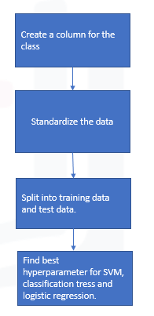
Predictive Analysis (Classification)
We loaded the data using numpy and pandas, transformed the data, split our data into training and testing.
We built different machine learning models and tune different hyperparameters using GridSearchCV.
We used accuracy as the metric for our model, improved the model using feature engineering and algorithm tuning.
We found the best performing classification model.
Source code Reference:
https://github.com/maina-duseja/DS-Capstone/blob/main/SpaceX_Machine_Learning_Prediction_Part_5.jupyterlite.ipynb

Slide 18

Results
Exploratory data analysis results
CCAFS LC-40, VAFB SLC-4E, KSC LC-39A and CCAFS SLC-40 are launch sites in space mission.
Total payload mass carried by boosters launched by Nasa(CRS) is 45596 KG.
Avg. payload mass carried by booster version F9 v1.1 is ~ 2534 KG.
The first successful landing outcome in group pad was achieved on 22nd December 2015.
Total number of successful outcome is 100 and failure outcome is 1
As the flight number increases, the first stage is likely to land successfully.
The more massive the payload, the less likely the first stage will return.
CCAFS LC-40, has a success rate of 60%, while KSC LC-39A and VAFB SLC 4E has a success rate of 77%.
VAFB-SLC launch site there are no rockets launched for heavy payload mass(greater than 10000)
With heavy payloads the successful landing or positive landing rate are more for Polar, LEO and ISS.
Success rate since 2013 kept increasing till 2020.

Slide 19
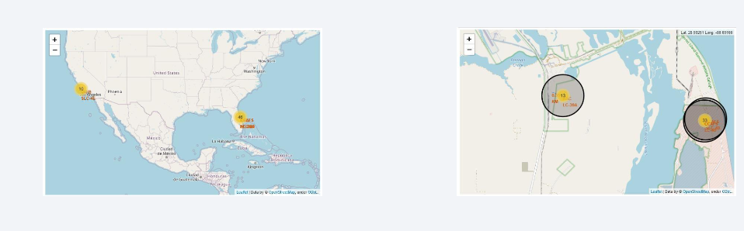
Results
Interactive analytics demo in screenshots
Launch sites are in close proximity to equator to minimize fuel consumption by using Earth eastward spin to help spaceships get into orbit.
Launch sites are in close proximity to coastline so they can fly over the ocean during launch, for at least two safety reasons:
Crew has option to abort launch and attempt water landing
Minimize people and property at risk from falling debris.
Launch sites are in close proximity to highways, which allows for easily transport required for people and property.
Launch sites are in close proximity to railways, which allows transport for heavy cargo.
Launch sites are not in close proximity to cities, which minimizes danger to population dense areas.

Slide 20
Results
Predictive analysis results
With FlightNumber, PayloadMass, Orbit and Launch site of Falcon 9 booster version as input we created model with Column Class representing success/failure outcome.
After comparing accuracy of Logistic Regression, Support Vector machines, Decision Tree Classifier and K-nearest neighbors algorithms we found they all perform the same.

Slide 21

Section 2

Slide 22
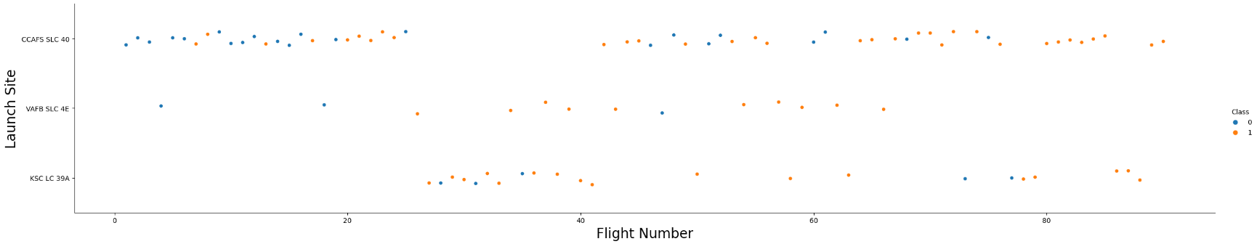
Flight Number vs. Launch Site
From the scatter plot below, we can say that higher the flight number, the greater the success at launch site.

Slide 23
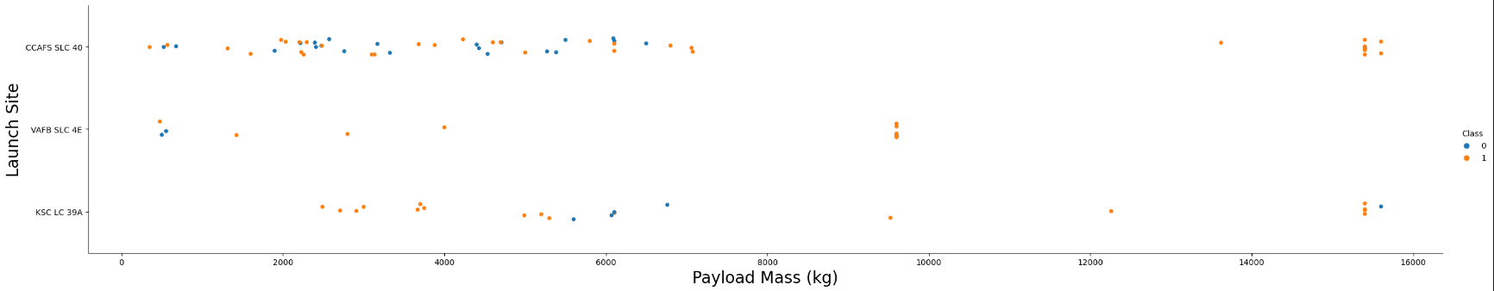
Payload vs. Launch Site
From the scatter plot below we can say that with heavy payloads the successful landing or positive landing rate are more and for the VAFB-SLC launch site there are no rockets launched for heavy payload mass(greater than 10000).

Slide 24
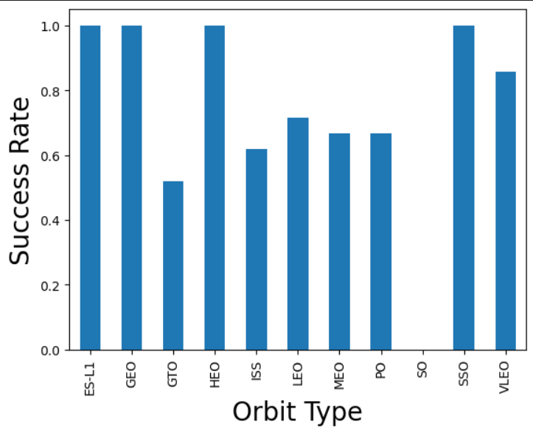
Success Rate vs. Orbit Type
From the plot, we can see that ES-L1, GEO, HEO, SSO, VLEO had the most success rate.

Slide 25
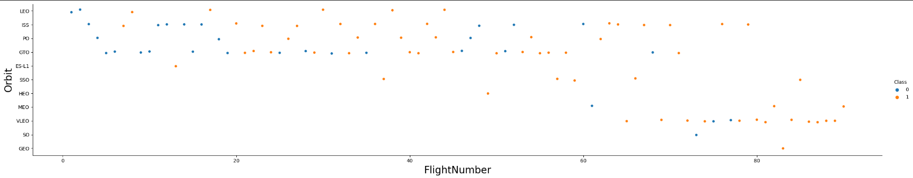
Flight Number vs. Orbit Type
From the scatter plot below we can see in the LEO orbit the Success appears related to the number of flights; on the other hand, there seems to be no relationship between flight number when in GTO orbit.

Slide 26
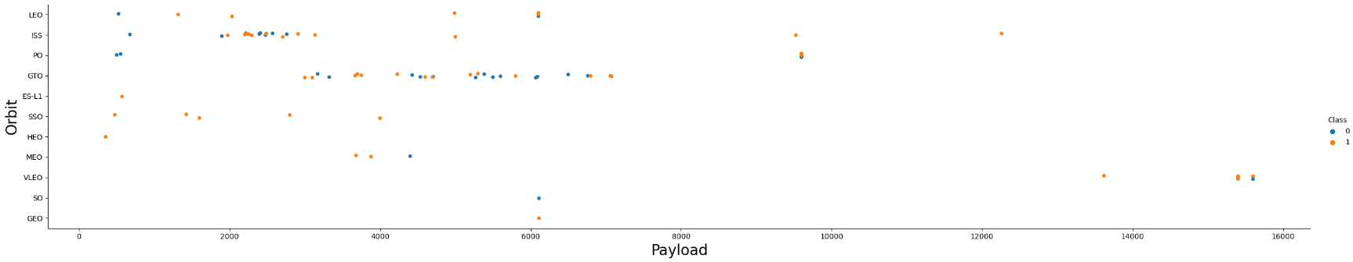
Payload vs. Orbit Type
With heavy payloads the successful landing or positive landing rate are more for Polar, LEO and ISS. However for GTO we cannot distinguish this well as both positive landing rate and negative landing(unsuccessful mission) both are there.

Slide 27
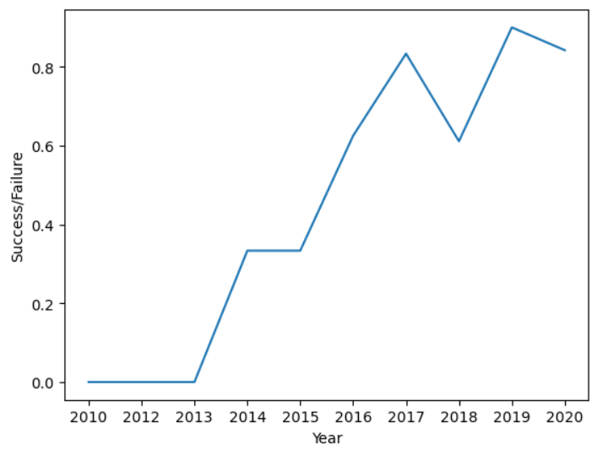
Launch Success Yearly Trend
We can observe that the success rate since 2013 kept increasing till 2020.

Slide 28
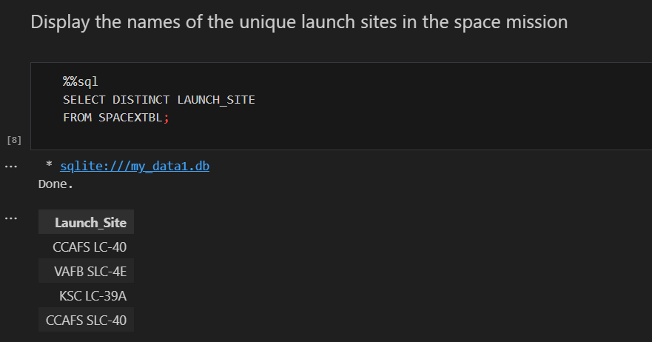
All Launch Site Names
With Distinct keyword on launch site we can get the unique list.

Slide 29
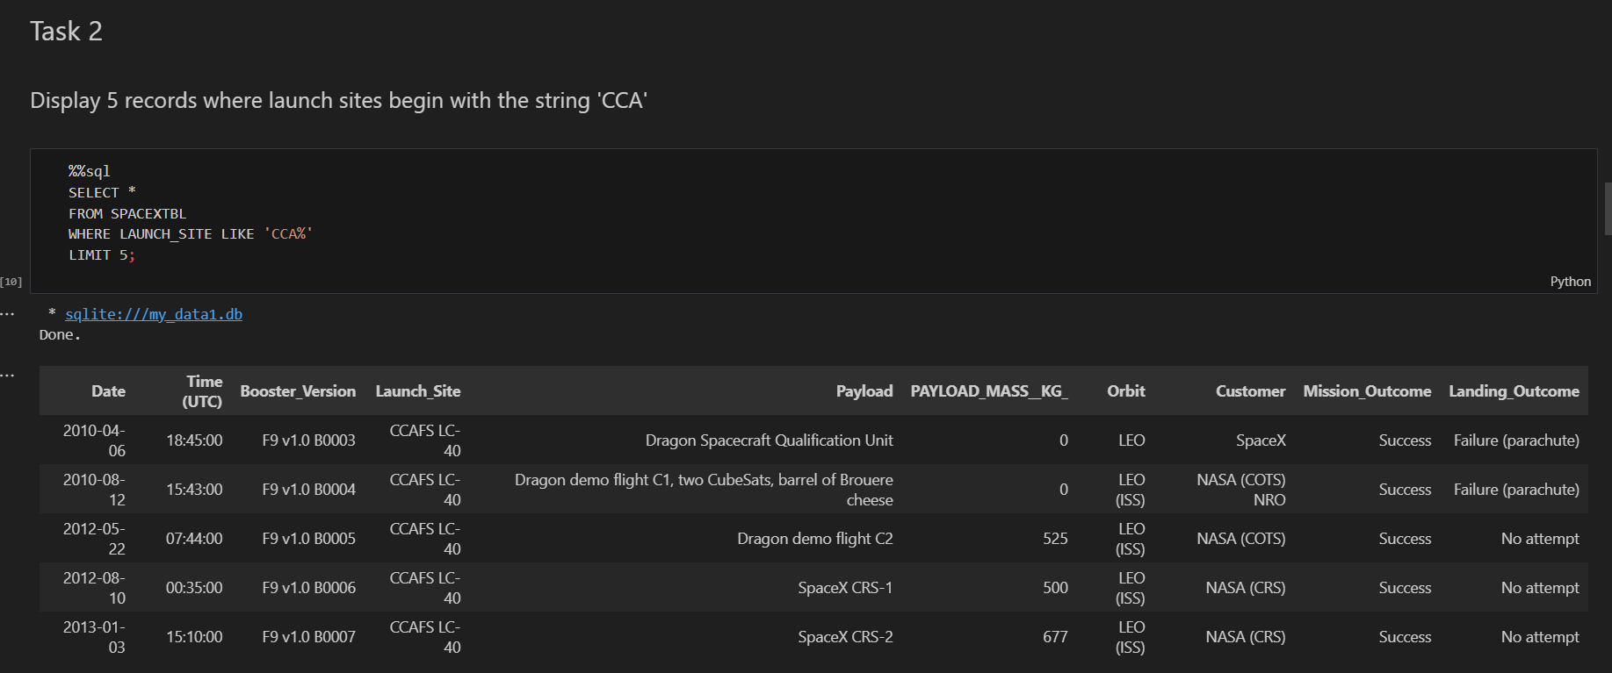
Launch Site Names Begin with 'CCA'
To begin launch sites with `CCA` we have used the like operator with ‘CCA%’ expression. % indicates any letters words after CCA.
For displaying only 5 records we used Limit as 5 to restrict displaying only 5 records.

Slide 30
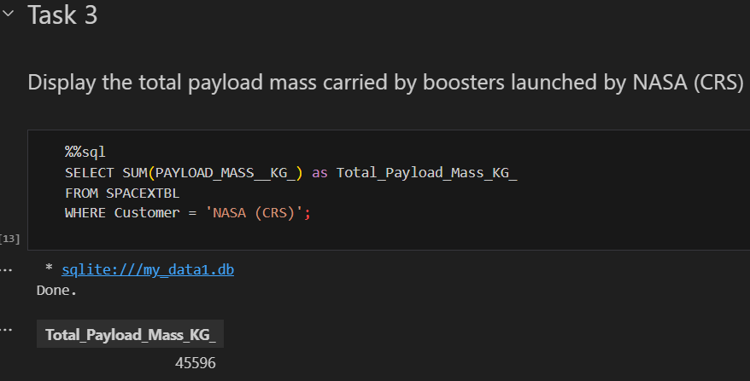
Total Payload Mass
We used sum function on Payload_Mass-KG_ column to get the total sum.

Slide 31
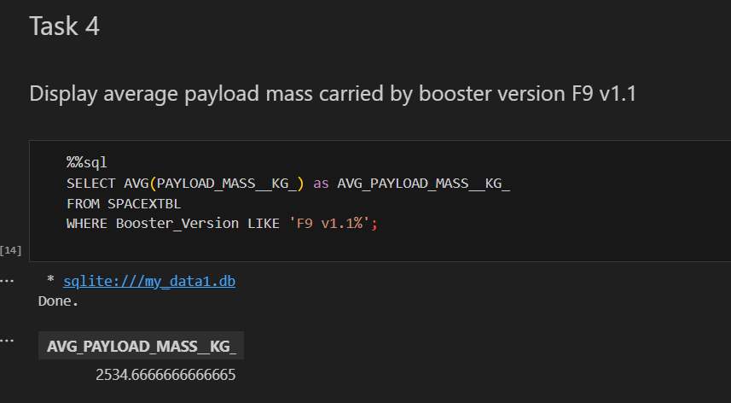
Average Payload Mass by F9 v1.1
We calculated the average payload mass carried by booster version F9 v1.1 with Avg function on ‘PAYLOAD_MASS__KG_’ column.

Slide 32
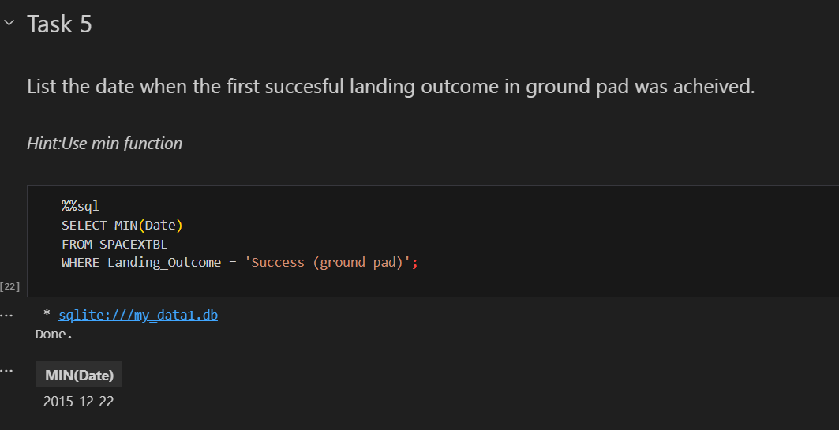
First Successful Ground Landing Date
To get the first successful landing outcome date on ground pad we used min function on Date column.

Slide 33
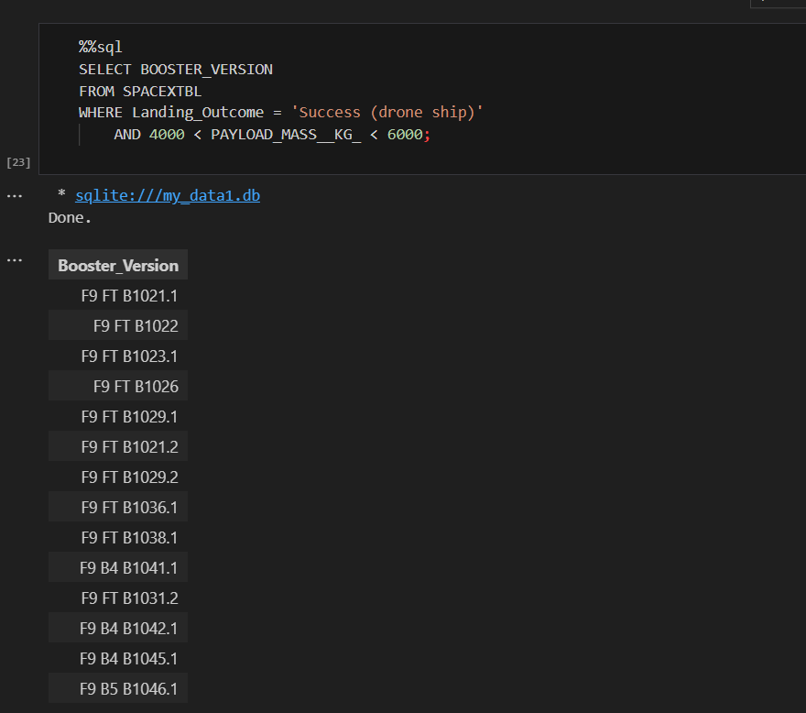
Successful Drone Ship Landing with Payload between 4000 and 6000
We used the WHERE clause to filter for boosters which have successfully landed on drone ship and applied the AND condition to determine successful landing with payload mass greater than 4000 but less than 6000

Slide 34
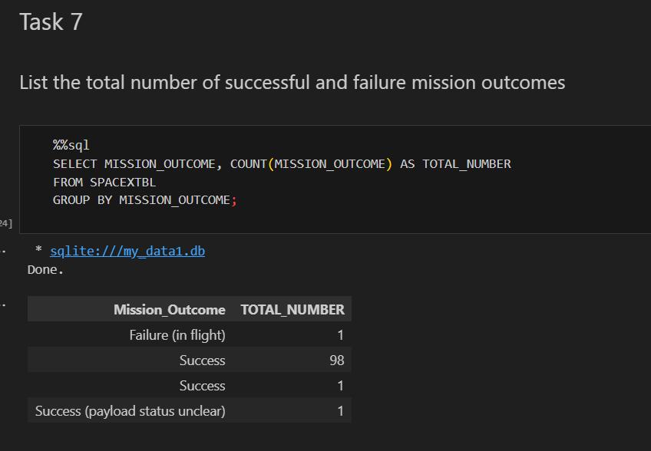
Total Number of Successful and Failure Mission Outcomes
To get the total number of successful and failure mission outcomes, we used the count function on “Mission_Outcome’ column and done group by on same.

Slide 35
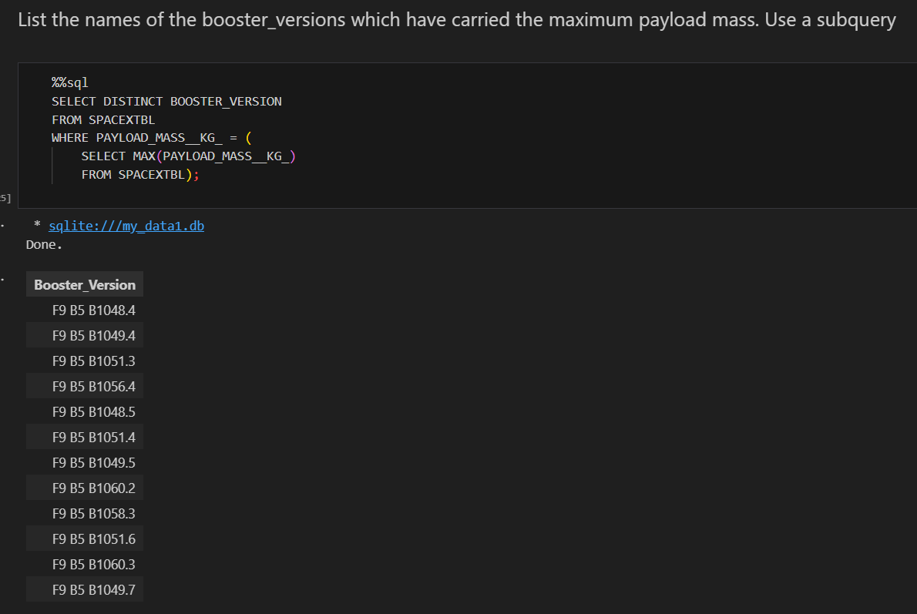
Boosters Carried Maximum Payload
We determined the booster that have carried the maximum payload using a subquery in the WHERE clause and the MAX() function on payload mass column.

Slide 36
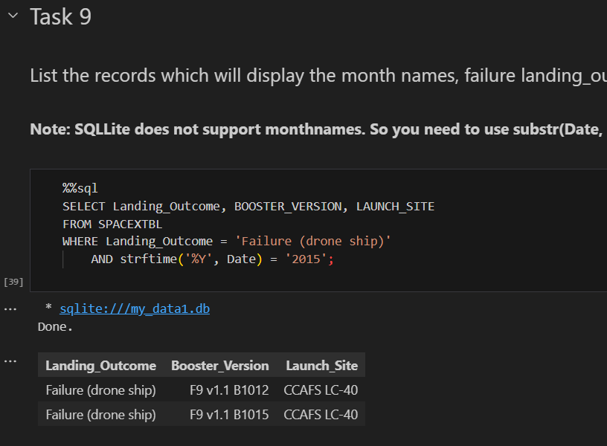
2015 Launch Records
To get the records for 2015 year, we used strftime method which represents a string representing date and time using date, time or datetime object.

Slide 37
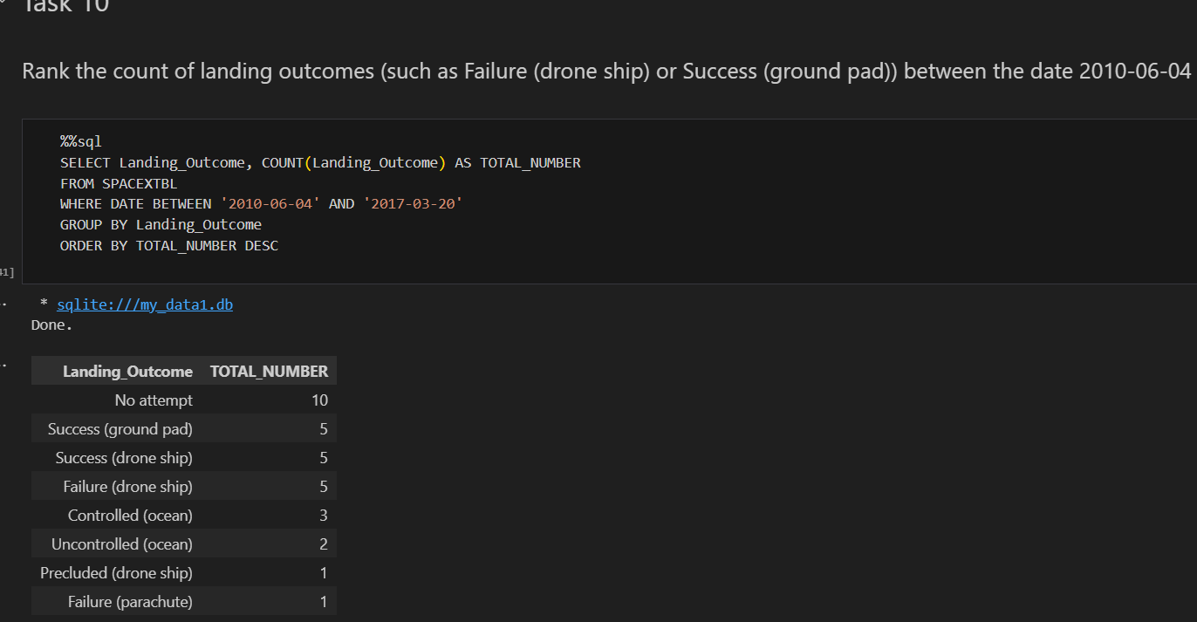
Rank Landing Outcomes Between 2010-06-04 and 2017-03-20
We selected Landing outcomes and the COUNT of landing outcomes from the data and used the WHERE clause to filter for landing outcomes BETWEEN 2010-06-04 to 2010-03-20.
We applied the GROUP BY clause to group the landing outcomes and the ORDER BY clause to order the grouped landing outcome in descending order.

Slide 38

Section 3

Slide 39
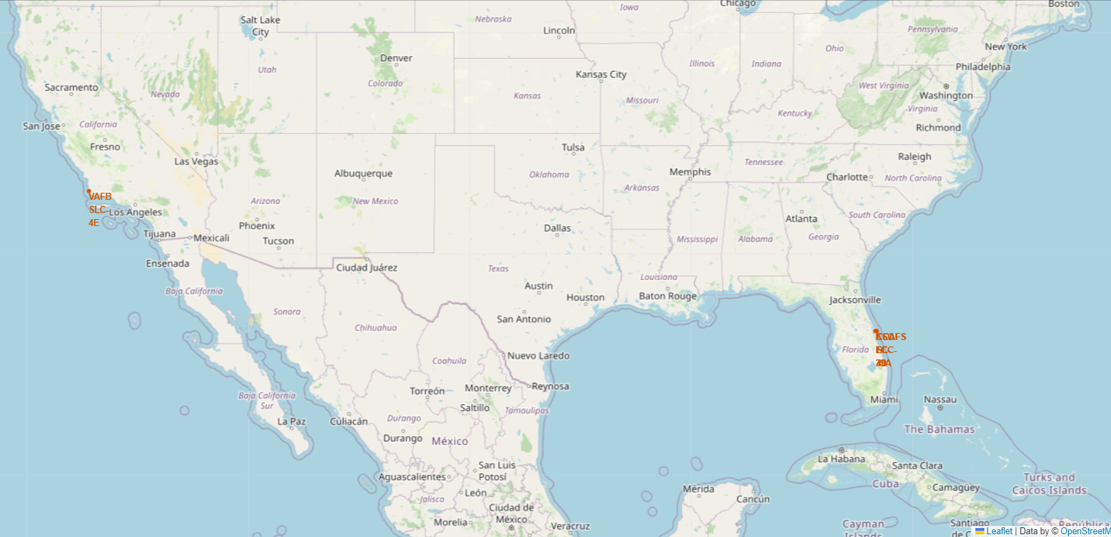
SpaceX Launch Sites
We can see SpaceX launch sites are at The Unites states of America’s coasts California and Florida.
All launch sites are in proximity to the equator and the coast.
The launch sites in close proximity to the coast are for safety reasons.

Slide 40
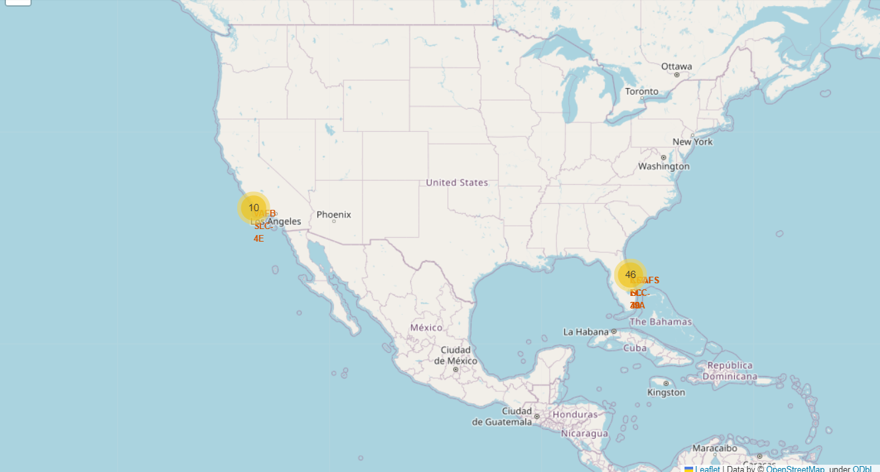
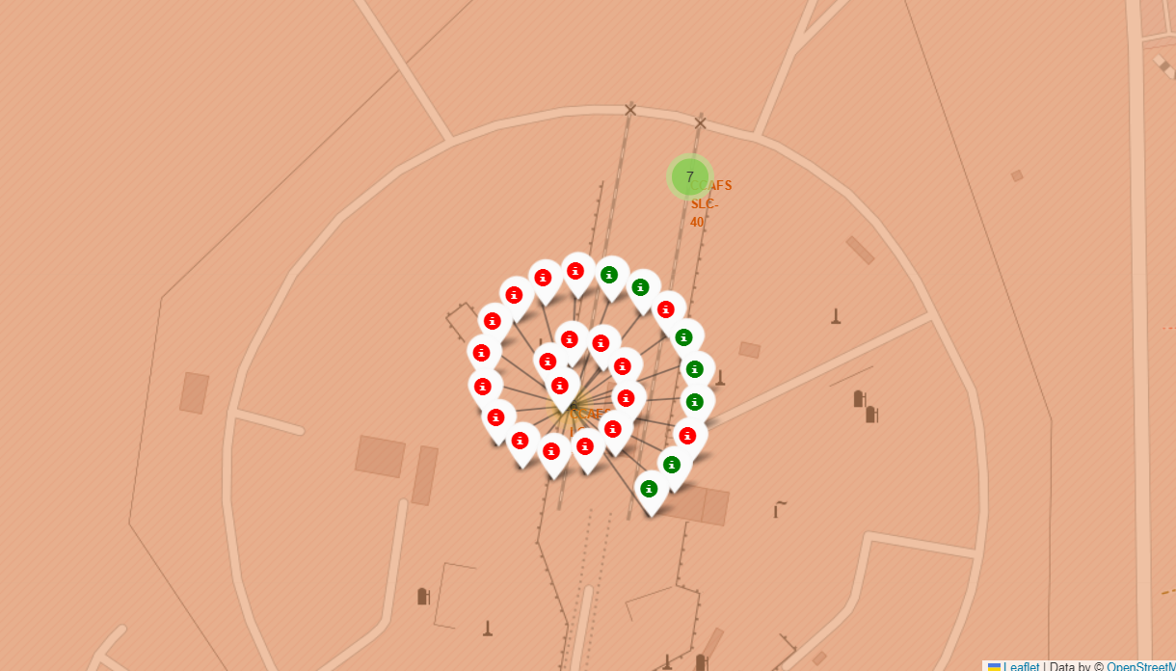
Success/Failed Launch Sites
We enhanced the map by adding the launch outcomes for each site to see which sites have high success rates. The numbers in yellow marker shows the total outcomes per site and green marker shows successful launches and Red Marker shows Failures.

Slide 41
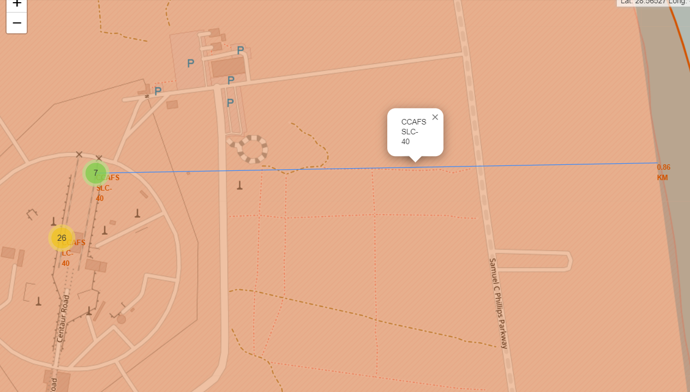
Distance between Launch Sites to proximities
We explored launch site and its closed proximities to find nearest railway, coastline and highway
As mentioned before, launch sites are in close proximity to equator to minimize fuel consumption by using Earth eastward spin to help spaceships get into orbit.
Launch sites are in close proximity to coastline so they can fly over the ocean during launch.
Launch sites are in close proximity to highways, which allows for easily transport required people and property.
Launch sites are in close proximity to railways, which allows transport for heavy cargo.
Launch sites are not in close proximity to cities, which minimizes danger to population dense areas.

Slide 42

Section 4

Slide 43
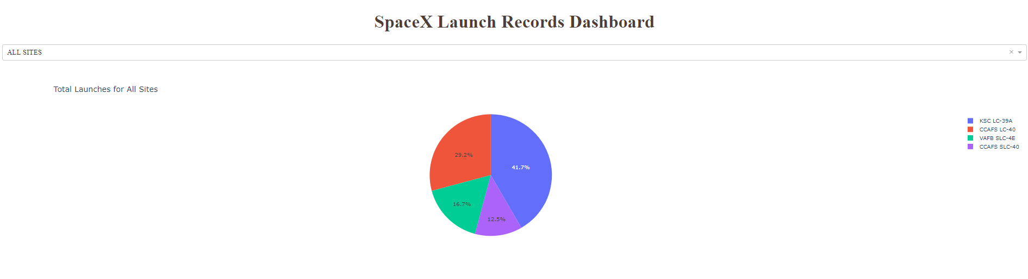
Success by all Launch Sites
Launch success count for all sites

Slide 44
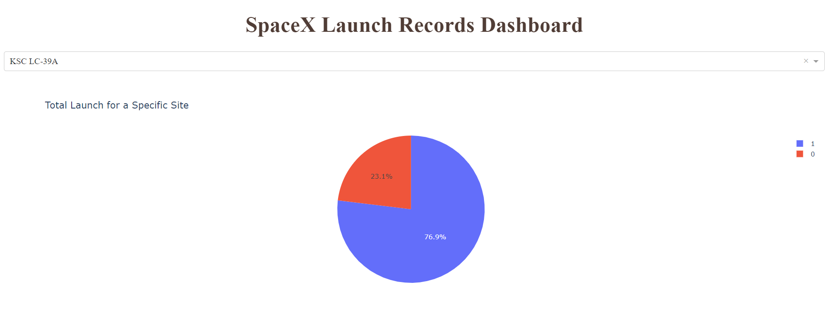
Launch site with highest success Ratio
KSC LC-39A has the highest success rate of 76.9%

Slide 45
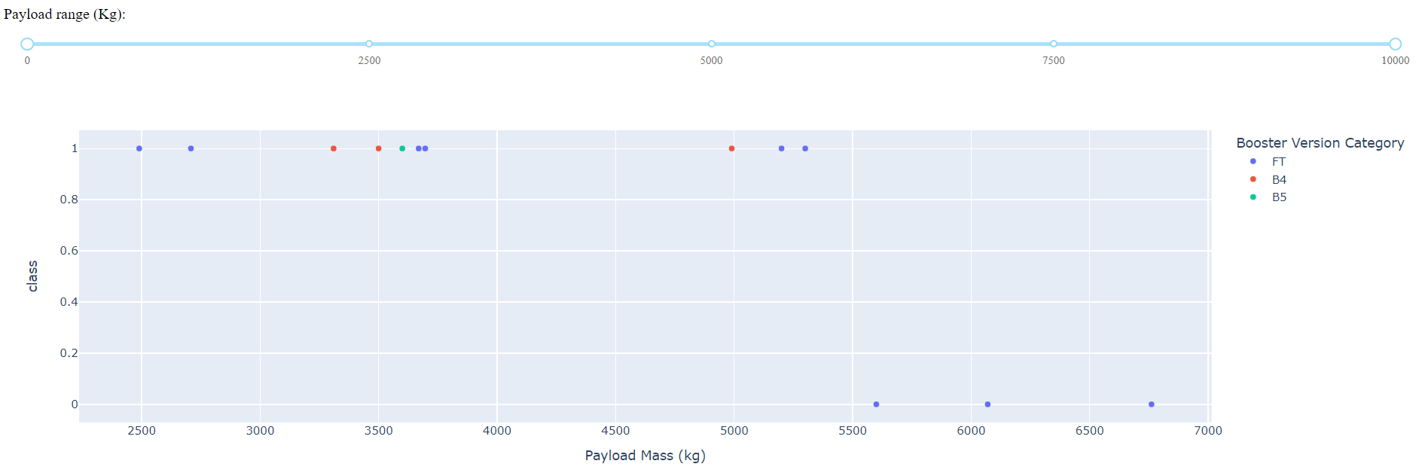
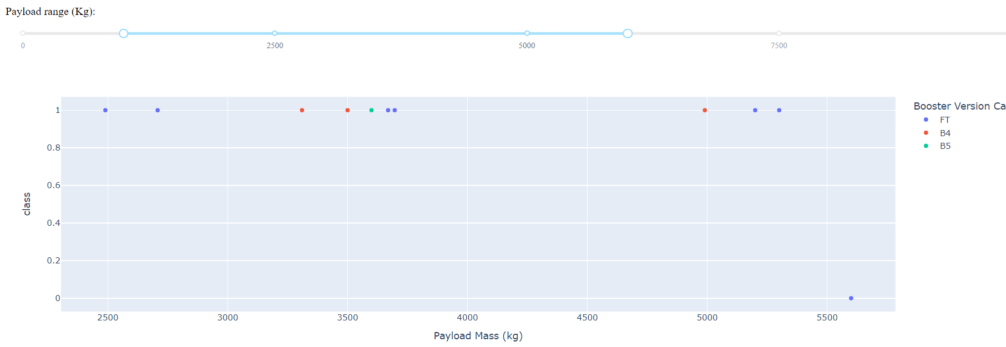
Payload vs. Launch Outcome scatter plot
Payload range between 2490 to 5300 has the highest success rate.
Between above range FT booster version has the highest success rate.

Slide 46

Section 5

Slide 47
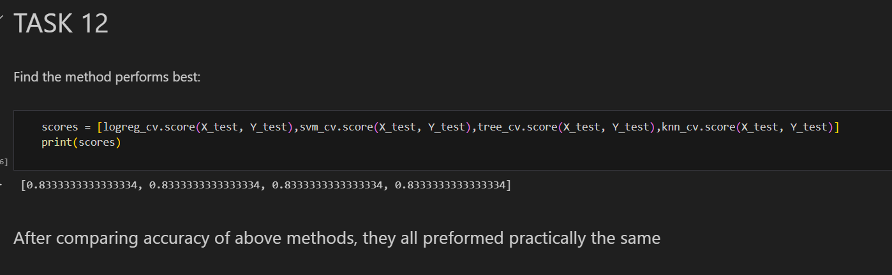
Classification Accuracy
The accuracy of all the models looks same.

Slide 48
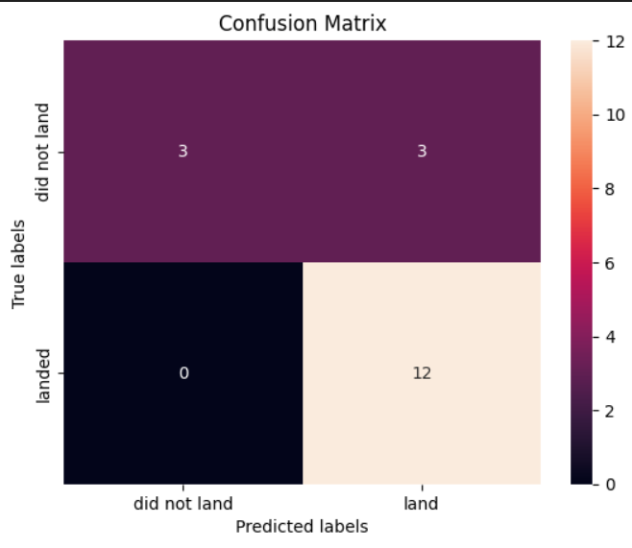
Confusion Matrix
The confusion matrix for all the model classifier shows that the classifier can distinguish between the different classes. The major problem is the false positives .i.e., unsuccessful landing marked as successful landing by the classifier.

Slide 49

Conclusions
CCAFS LC-40, VAFB SLC-4E, KSC LC-39A and CCAFS SLC-40 are launch sites in space mission.
The larger the flight amount, the greater the success rate at a launch site.
Success rate since 2013 kept increasing till 2020.
Orbits ES-L1, GEO, HEO, SSO, VLEO had the most success rate.
KSC LC-39A had the most successful launches of any sites.
Logistic Regression, Support Vector machines, Decision Tree Classifier and K-nearest neighbors models gave similar accuracy and anyone can be chosen for machine learning algorithm model and tuning

Slide 50
Appendix
Githhub Project Source code Reference:
https://github.com/maina-duseja/DS-Capstone/tree/main

Slide 51


